Slide 1
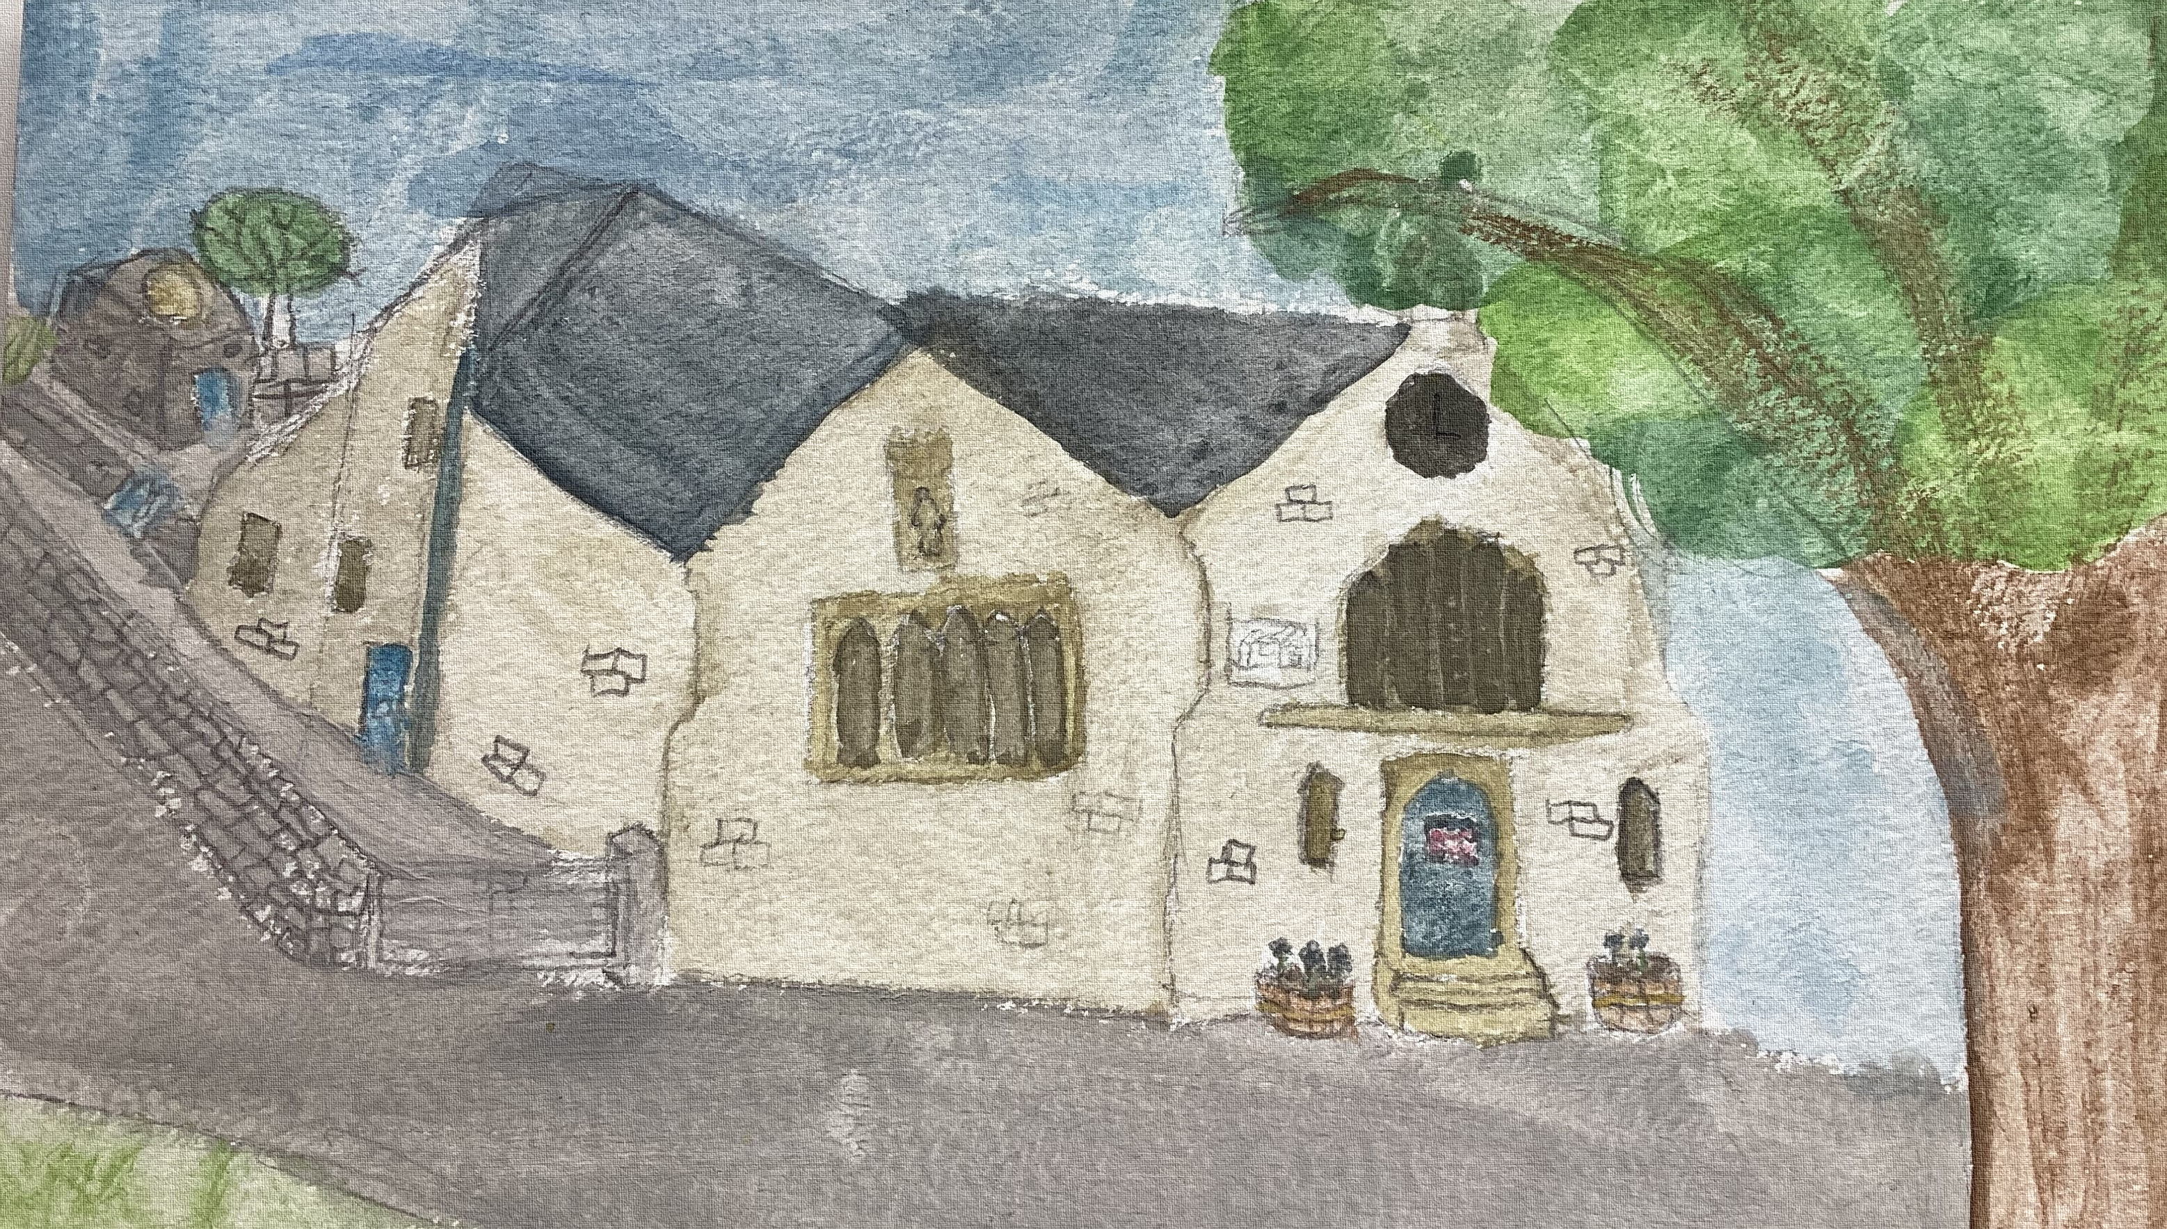

Litton CE Primary School
Toddler Group
Woodland Adventures
Every Thursday
10.30am – 11.30am
Meet new friends
In the school hall @ Litton School.
For more information call 01298 871449
Free of charge - Refreshments provided

