Slide 1
The Iron Man by Ted Hughes

Slide 2
Chapter 1
We are focusing on the vocabulary found with in Chapter 1 today. Remember to read through the questions first before you read the chapter so that you can identify the vocabulary you are concentrating on.

Slide 3
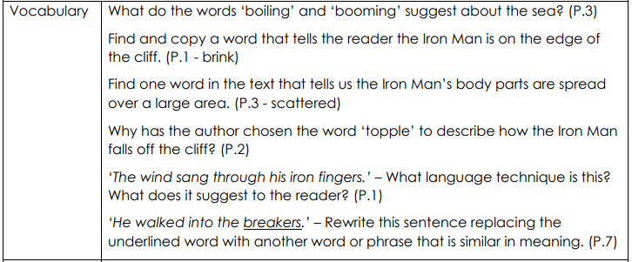

Slide 4
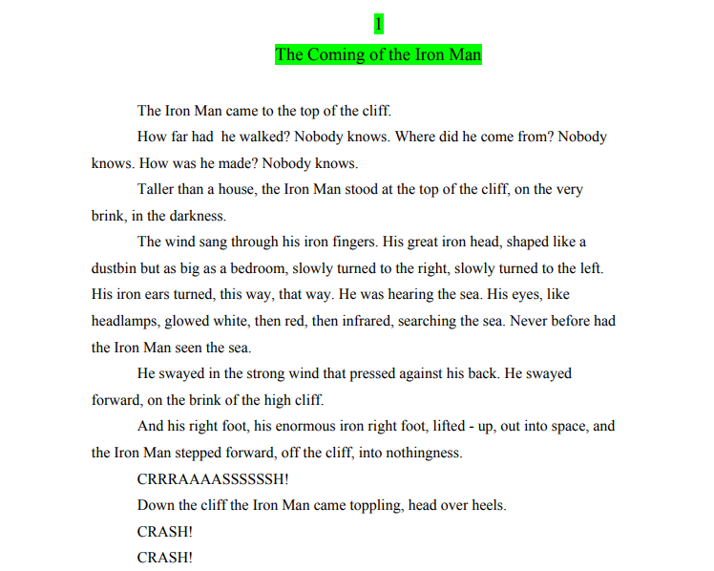

Slide 5
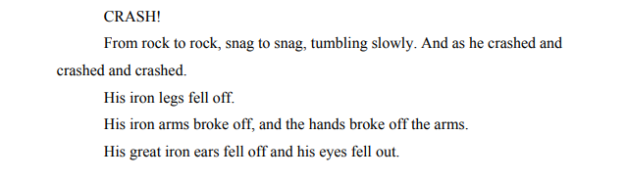
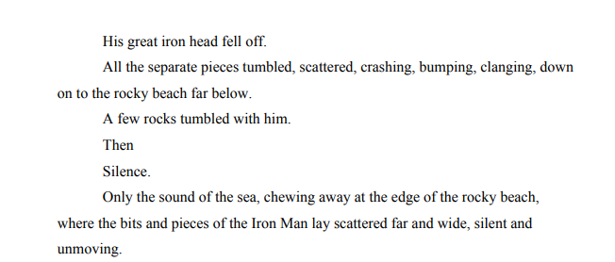

Slide 6
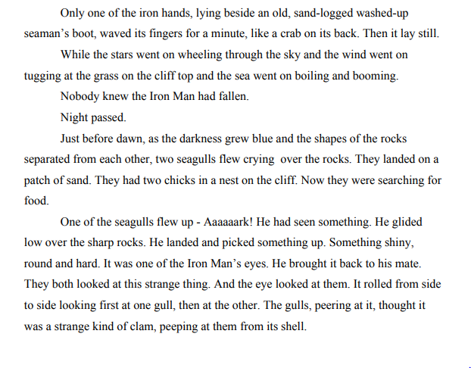

Slide 7
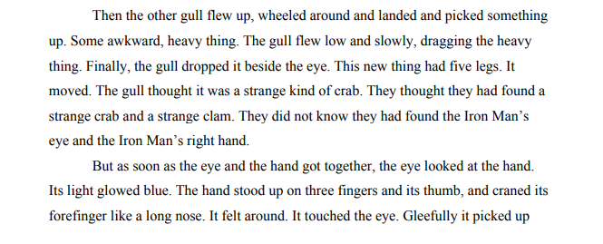
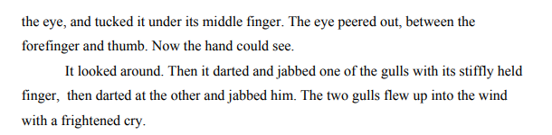

Slide 8
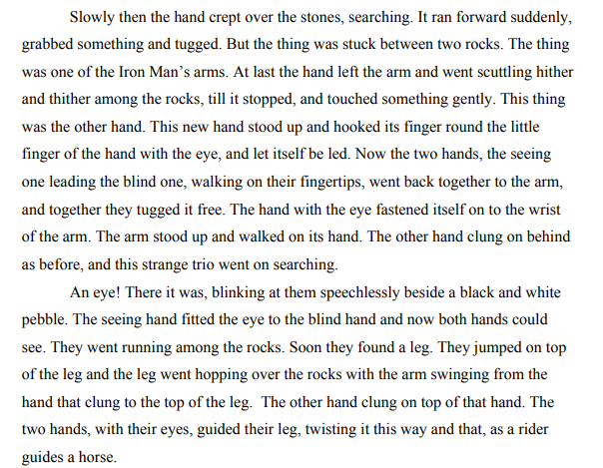

Slide 9
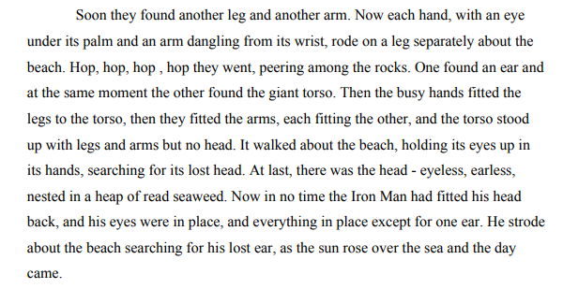

Slide 10


